Slide 1
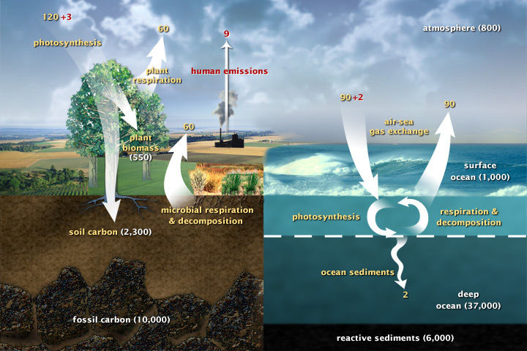
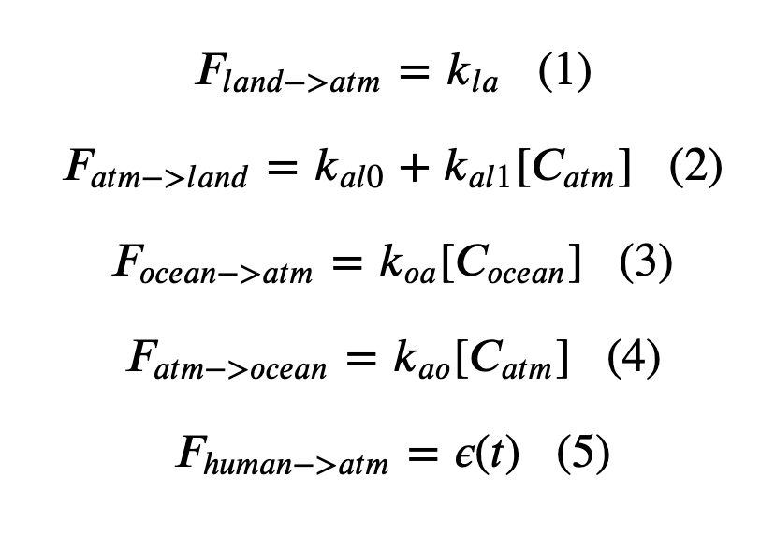
Cambio1.0
Euler’s method:
In a loop, we calculated fluxes

Slide 2
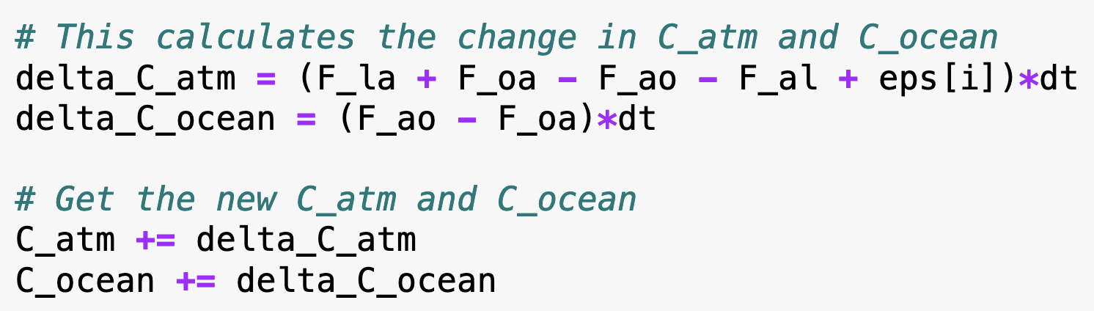
Cambio1.0
Euler’s method:
Then we calculated changes to the concentrations in the atmosphere and oceans

Slide 3
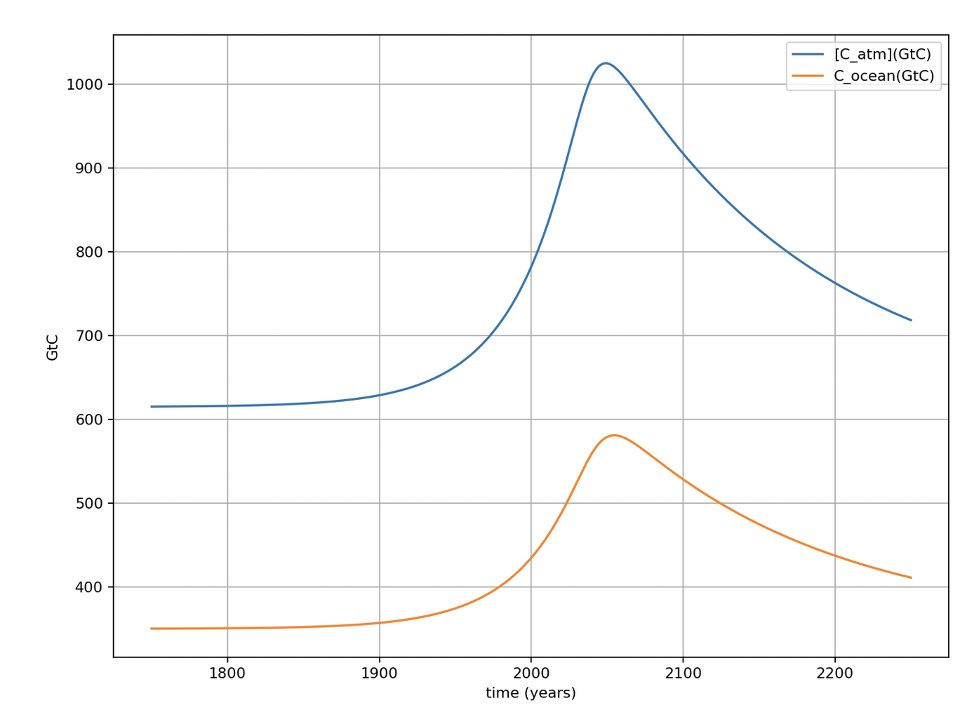
Amounts in the atmosphere and the upper ocean
615 GtC in air (pre-industrial)
Pre-industrial carbon amounts
350 GtC in upper ocean (pre-industrial)

Slide 4
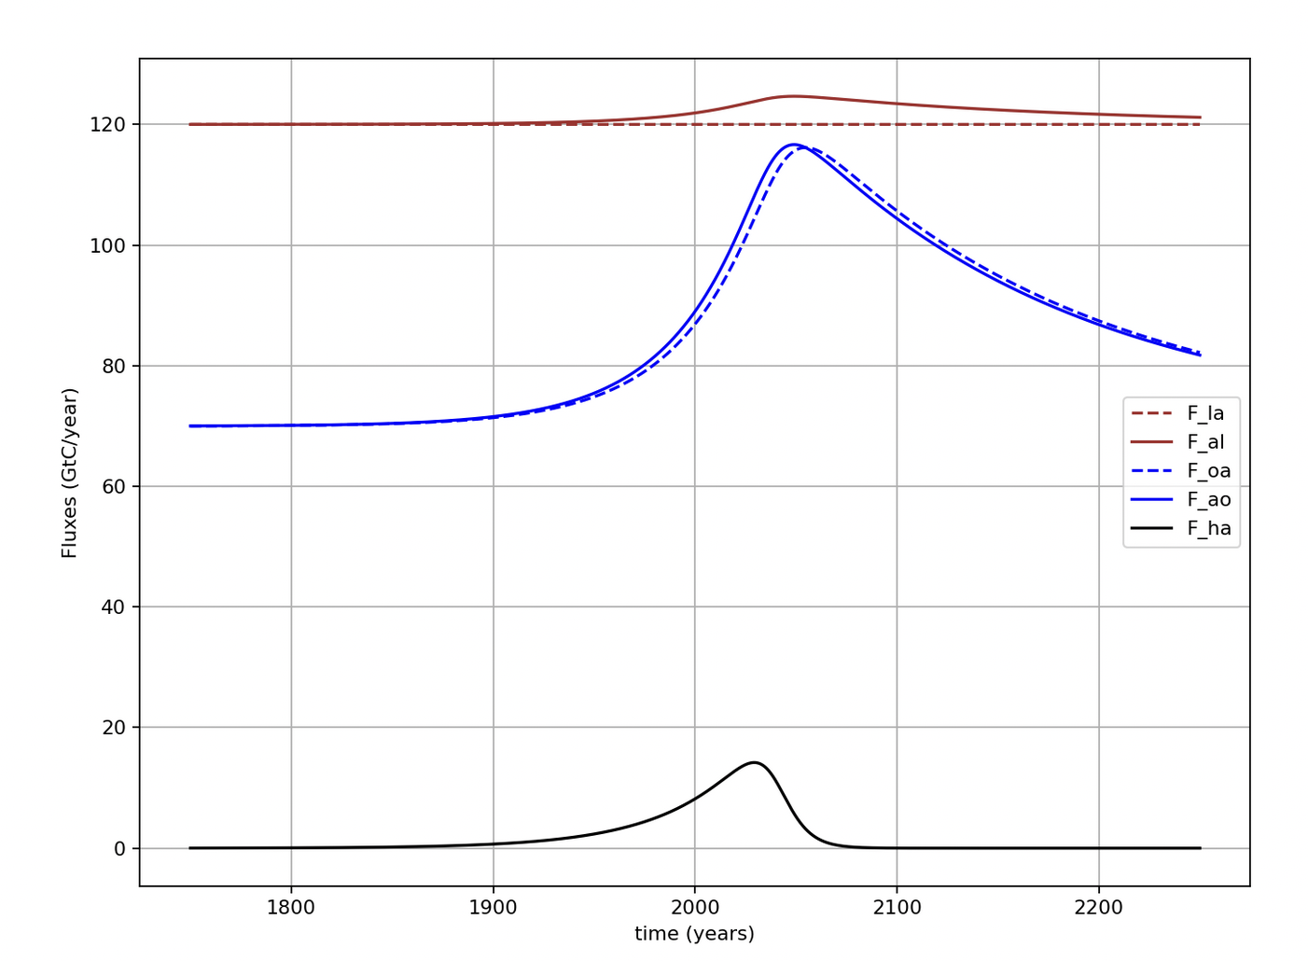
Clear that we’re modeling small differences between big numbers (fluxes)

Slide 5
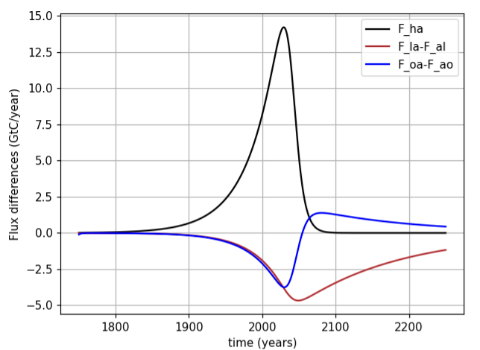
Right now (year 2022) it looks like net fluxes to land and oceans are about ¼ of anthropogenic flux to atmosphere
We can say that the sum of these sinks (about ½ of anthropogenic flux) is Earth’s ”free” ecosystem service

Slide 6
But oceans are more like a lending library
Oceans become a net source of carbon around mid-century
Peak net ocean-to-atmosphere flux

Slide 7
New idea for the day: Three types of variables in climate modeling
Parametric variables
Specified outside the Euler loop
Could be constant or time-dependent
Prognostic variables
Appear on the left-hand-side and the right-hand-side of assignments in the loop (i.e., calculated and used to calculate other variables)
Diagnostic variables
Appear on the left-hand-side of assignments in the loop, but not on the right-hand-side (i.e., they’re calculated, even graphed, but not otherwise used)

Slide 8
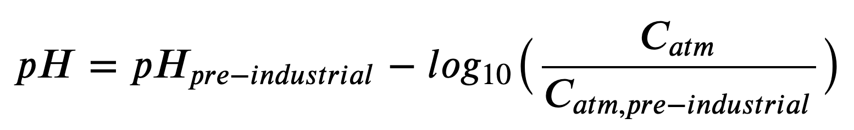
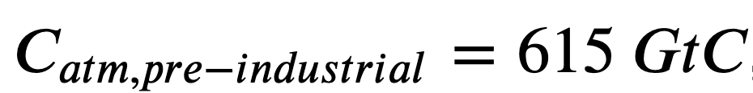











Ocean pH as a diagnostic variable
Air
$$CO_{2}$$
$$H_{2}O$$
$$H_{2}O$$
Oceans
$H_{2}CO_{3}$
$$H^{+}$$
$$H^{+}$$
$$HCO_{3}^{−}$$
$${Ca}^{2+}$$
$$CO_{3}^{2−}$$
Sea floor
$$CaCO_{3}$$
$$CaCO_{3}^{}$$

Slide 9
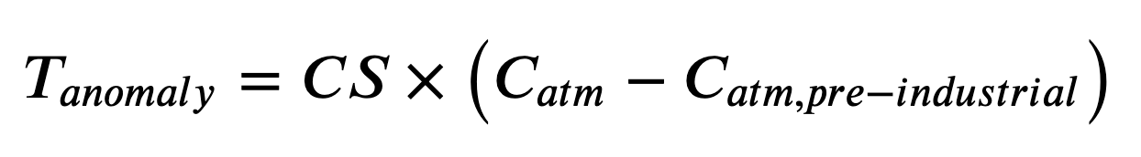
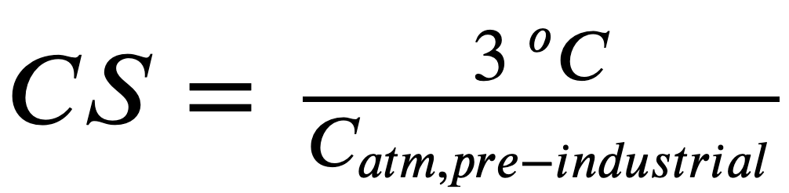
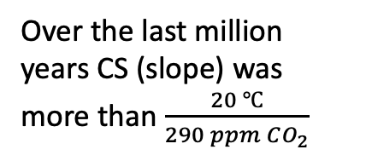

The temperature anomaly as a diagnostic variable
Over the last million years CS (slope) was more than $\frac{20 ℃}{290 ppm CO_{2}}$
T (relative to 1960)
Over the last 150 years, CS has been about $\frac{2.7 ℃}{290 ppm CO_{2}}$
Courtesy Penny Rowe
Courtesy Penny Rowe

Slide 10
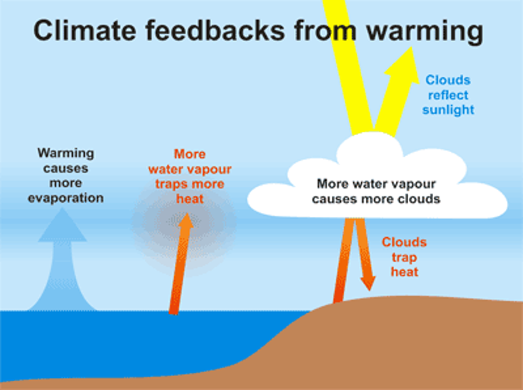
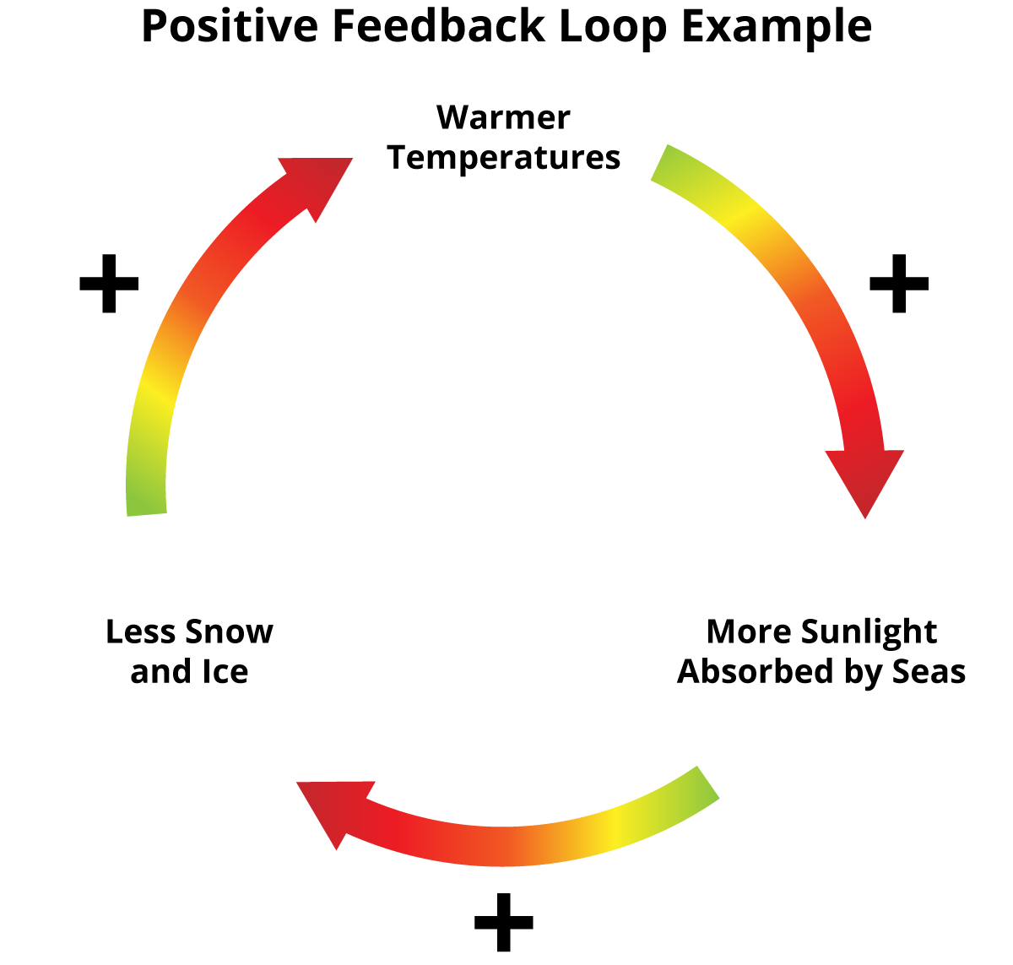
Diagnostic variables can become prognostic if we code in feedbacks
Parametric variables
Specified outside the Euler loop
Could be constant or time-dependent
Prognostic variables
Appear on the left-hand-side and the right-hand-side of assignments in the loop (i.e., calculated and used to calculate other variables)
Diagnostic variables
Appear on the left-hand-side of assignments in the loop, but not on the right-hand-side (i.e., they’re calculated, even graphed, but not otherwise used)
Temperature <-> cloud-albedo feedback was wishful thinking -- it’s not happening
Temperature <->
ice-albedo feedback
really is happening in real life (although not in Cambio1.1)

